Slide 1

TASK 2
-

Slide 2

DATA PREPROCESSING

Slide 3
REMOVING DUPLICATES
Check:
df.duplicated().sum() → 0 duplicates found
Effect:
Even though no duplicates existed, checking ensures we eliminate any repeated records that could skew learning or introduce redundancy.
MISSING VALUES
Check:
df.info() → No null values
Effect:
No need for imputation or row removal. Clean data leads to better model stability and fewer assumptions during training.

Slide 4
OUTLIER DETECTION – IQR METHOD
Technique:
Interquartile Range (IQR) = Q3 - Q1
Outliers = data points outside [Q1 - 1.5IQR, Q3 + 1.5IQR]
Effect:
Detects extreme values that may distort patterns or cause models to overfit.
OUTLIER HANDLING – CLIPPING
Method Used:
Capping extreme values at a defined upper and lower threshold.
Effect:
Reduces the influence of outliers while keeping the data within reasonable bounds — especially useful for models sensitive to scale like Linear Regression.

Slide 5
RENAMING UNCLEAR COLUMNS
Action:
Renamed ambiguous column names to clearer, meaningful names.
Effect:
Improves dataset readability and makes the pipeline easier to maintain and interpret, especially in collaboration.
FEATURE SCALING – STANDARDSCALER
Technique:
Standard scaling (Z-score normalization)
Effect:
Centers data to mean 0 and std 1
Essential for distance-based models (e.g., SVM, KNN) and gradient-based optimization

Slide 6
POLYNOMIAL FEATURES
Technique:
Created new features by combining original ones
Effect:
Adds non-linearity to linear models
Helps uncover hidden relationships in the data
Increases feature space, which may improve performance but can also raise overfitting risk
SUMMARY
NO DUPLICATES OR MISSING VALUES
OUTLIERS HANDLED WITH CLIPPING AFTER IQR CHECK
FEATURES RENAMED FOR CLARITY
STANDARDIZED FEATURES FOR MODEL PERFORMANCE
EXTENDED FEATURE SPACE WITH POLYNOMIAL COMBINATIONS

Slide 7
FOCUS: TRAINING, TESTING & MODELING

Slide 8
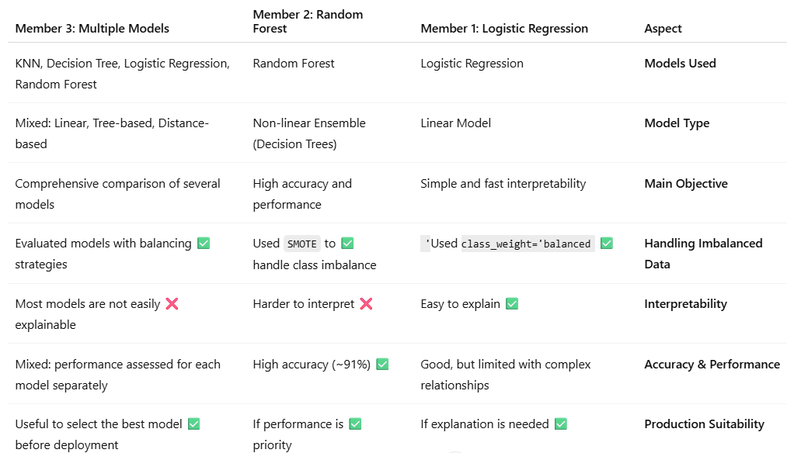
📊 OVERVIEW OF MODELS USED BY TEAM

Slide 9
🔍 KEY STEPS (SHARED BY ALL MEMBERS)
DATA SPLITTING: USING TRAIN_TEST_SPLIT
DATA SCALING: USING STANDARDSCALER WHEN NEEDED
MODEL EVALUATION:
ACCURACY_SCORE
CLASSIFICATION_REPORT
CONFUSION_MATRIX

Slide 10
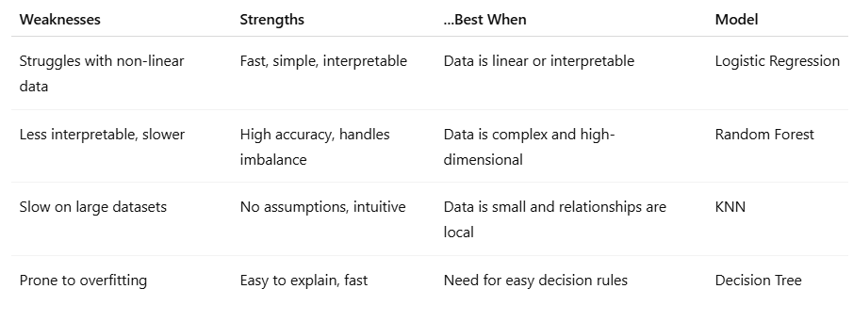
🧠 COMPARISON BETWEEN MODELS

Slide 11
FINAL RECOMMENDATION BASED ON MODEL COMPARISON:
✅ BEST PERFORMING MODEL: RANDOM FOREST
ACCURACY ~91%
BALANCED PERFORMANCE (PRECISION & RECALL)
CAPTURES COMPLEX RELATIONSHIPS
🧠 BEST INTERPRETABLE MODEL: LOGISTIC REGRESSION
CLEAR COEFFICIENTS
USEFUL FOR FEATURE IMPORTANCE & BUSINESS INSIGHT

Slide 12
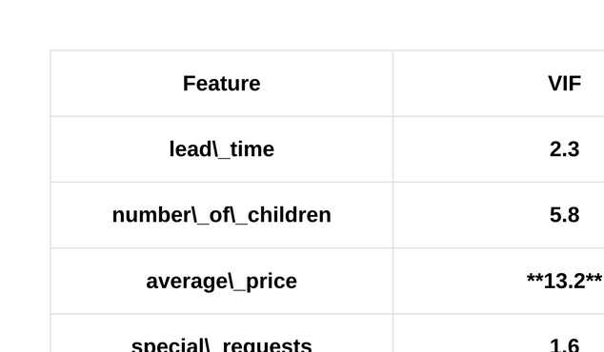
FEATURE ENGINEERING & MULTICOLLINEARITY HANDLING
CATEGORICAL FEATURES WERE ENCODED USING ONE-HOT ENCODING
NUMERICAL FEATURES WERE SCALED USING STANDARDSCALER
MULTICOLLINEARITY WAS CHECKED USING VIF (VARIANCE INFLATION FACTOR)
FEATURES WITH VIF > 10 WERE CONSIDERED FOR REMOVAL
RESULT: MORE STABLE AND ACCURATE MODEL

Slide 13
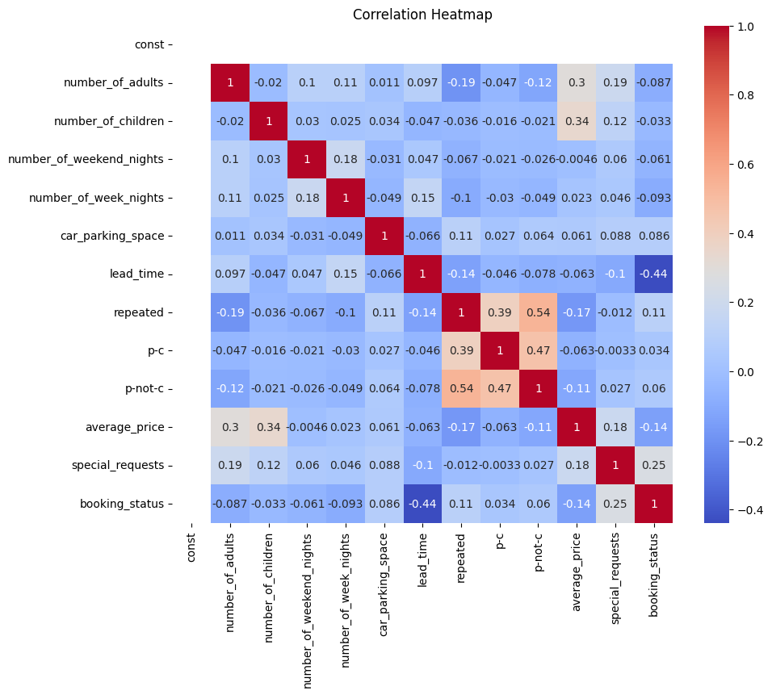
FEATURE ENGINEERING & MULTICOLLINEARITY HANDLING

Slide 14
CONCLUSION
PREPROCESSING:
CLEANED THE DATASET, REMOVED DUPLICATES, AND HANDLED OUTLIERS
FEATURE ENGINEERING:
ENCODED CATEGORICAL FEATURES, SCALED NUMERICAL ONES, AND REMOVED MULTICOLLINEARITY USING VIF
MODELING:
TRAINED LOGISTIC, LINEAR, AND POLYNOMIAL REGRESSION MODELS WITH SOLID EVALUATION (ACCURACY, R², MSE)
INSIGHT:
BOOKING CANCELLATIONS ARE INFLUENCED BY LEAD TIME, REPEAT GUESTS, ROOM TYPE, AND PRICING.
THESE FINDINGS CAN HELP HOTELS REDUCE CANCELLATIONS AND IMPROVE DECISION-MAKING.

Slide 15
THANK YOU

